Slide 1
Distributed Systems
System Model, Resource Vs Communication deadlocks,
by
Ms. Neha Shukla
(B.Tech, M.Tech, Ph.D*)
CSE Department
KIET Group of Institutions

Slide 2
Contents
System Model
Resource Vs Communication Deadlocks,

Slide 3
System Model
The systems have only reusable resources
Processes are allowed only exclusive access to resources
There is only one copy of each resource.
Process can be in 2 states: Active state( Running state where A process has all the resources and is either executing or ready for execution)
Blocked state: A process waiting to acquire some resources.

Slide 4
Deadlocks
Four conditions
1. Mutual exclusion.A resource can be held by at most one process
2. Hold and wait.Processes that already hold resources can wait for another resource.
3. Non-preemption.A resource, once granted, cannot be taken away from a process.
4. Circular wait.Two or more processes are waiting for resources geld by one of the other processes.

Slide 5
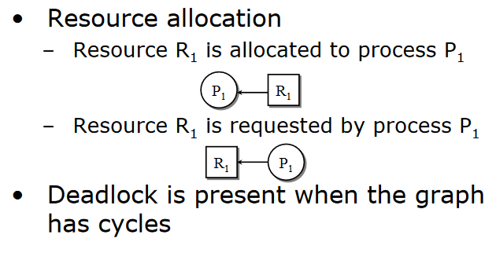

Slide 6
Types of Distributed Deadlock according to SinShi94:
Resource Deadlock
  In resource deadlocks, processes can simultaneously wait for several resources
  and cannot proceed until they have acquired all those resources.
  A set of processes is resource-deadlocked if each process in the set requests
  resources held by another process in the set and it must receive all of the requested
  resources before it can become unblocked."

Slide 7
  Communication Deadlock
    "In communication deadlocks, processes wait to communicate with other processes among a set of processes.
    A waiting process can unblock on receiving a communication from one of these processes.
    A set of processes is communication-deadlocked if each process in the set is waiting to communicate with another process in the set and no
    process ever initiates any further communication until it receives the communication for which it is waiting."

Slide 8
Thank
You

